Slide 1
Queue MCQs
Gate Preparatory Lectures

Slide 2
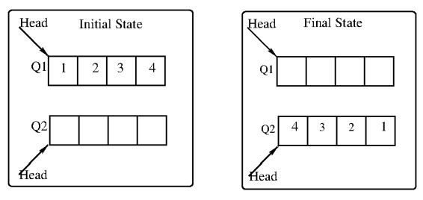
GATE | CS 2022 | Question 61
Consider the queues Q1 containing four elements and Q2 containing none (shown as the Initial State in the figure). The only operations allowed on these two queues are Enqueue(Q, element) and Dequeue(Q). The minimum number of Enqueue operations on Q1 required to place the elements of Q1 in Q2 in reverse order (shown as the Final State in the figure) without using any additional storage is___________.

Slide 3
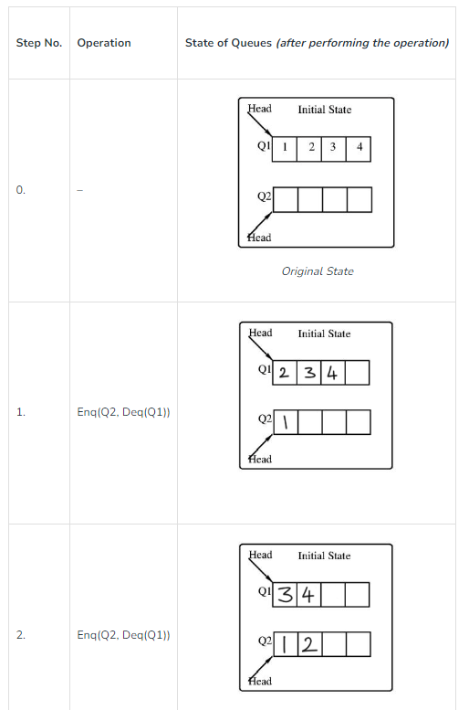
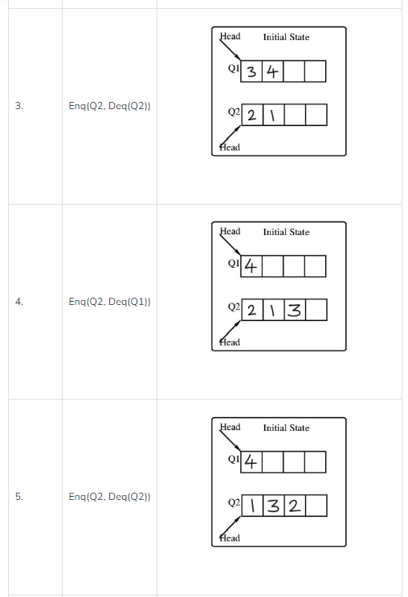
Solution

Slide 4
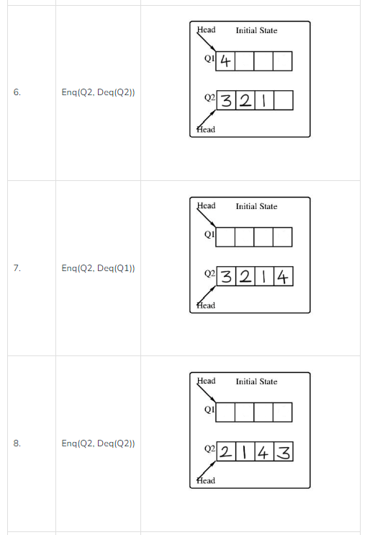
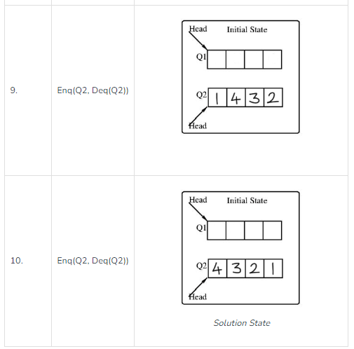
Solution

Slide 5
GATE | GATE CS 1996 | Question 12
Consider the following statements:
First-in-first out types of computations are efficiently supported by STACKS.
Implementing LISTS on linked lists is more efficient than implementing LISTS on an array for almost all the basic LIST operations.
Implementing QUEUES on a circular array is more efficient than implementing QUEUES on a linear array with two indices.
Last-in-first-out type of computations are efficiently supported by QUEUES. Which of the following is correct?
(A) (ii) and (iii) are true (B) (i) and (ii) are true (C) (iii) and (iv) are true (D) (ii) and (iv) are true

Slide 6
GATE | GATE CS 1996 | Question 12
Consider the following statements:
First-in-first out types of computations are efficiently supported by STACKS.
Implementing LISTS on linked lists is more efficient than implementing LISTS on an array for almost all the basic LIST operations.
Implementing QUEUES on a circular array is more efficient than implementing QUEUES on a linear array with two indices.
Last-in-first-out type of computations are efficiently supported by QUEUES. Which of the following is correct?
(A) (ii) and (iii) are true (B) (i) and (ii) are true (C) (iii) and (iv) are true (D) (ii) and (iv) are true Answer: (A) Explanation: i -STACK is the data structure that follows Last In First Out (LIFO) or First In Last Out (FILO) order, in which the element which is inserted at last is removed out first.
ii – Implementing LISTS on linked lists is more efficient than implementing it on an array for almost all the basic LIST operations because the insertion and deletion of elements can be done in O(1) in Linked List but it takes O(N) time in Arrays.
iii- Implementing QUEUES on a circular array is more efficient than implementing it on a linear array with two indices because using circular arrays, it takes less space and can reuse it again.
iv – QUEUE is the data structure that follows First In First Out (FIFO) or Last In Last Out (LILO) order, in which the element which is inserted first is removed first.
only (ii) and (iii) are TRUE. Option (A) is correct.

Slide 7
GATE | GATE-CS-2016 (Set 1) | Question 20
A queue is implemented using an array such that ENQUEUE and DEQUEUE operations are performed efficiently. Which one of the following statements is CORRECT (n refers to the number of items in the queue)?
(A) Both operations can be performed in O(1) time (B) At most one operation can be performed in O(1) time but the worst case time for the other operation will be Ω(n) (C) The worst case time complexity for both operations will be Ω(n) (D) Worst case time complexity for both operations will be Ω(log n)

Slide 8
GATE | GATE-CS-2016 (Set 1) | Question 20
A queue is implemented using an array such that ENQUEUE and DEQUEUE operations are performed efficiently. Which one of the following statements is CORRECT (n refers to the number of items in the queue)?
(A) Both operations can be performed in O(1) time (B) At most one operation can be performed in O(1) time but the worst case time for the other operation will be Ω(n) (C) The worst case time complexity for both operations will be Ω(n) (D) Worst case time complexity for both operations will be Ω(log n) Answer: (A)
Front and Rear are already Ready, pointing to the First element in Queue and Last Position in Queue,
In constant time, Insertion and Deletion will take place

Slide 9
ISRO | ISRO CS 2017 | Question 53
The minimum number of stacks needed to implement a queue is (A) 3 (B) 1 (C) 2 (D) 4

Slide 10
ISRO | ISRO CS 2017 | Question 53
The minimum number of stacks needed to implement a queue is (A) 3 (B) 1 (C) 2 (D) 4 Answer: (C)
Keep 2 stacks, let's call them inbox and outbox.
Enqueue:
Push the new element onto inbox
Dequeue:
If outbox is empty, refill it by popping each element from inbox and pushing it onto outbox
Pop and return the top element from outbox

Slide 11
ISRO | ISRO CS 2014 | Question 36
Consider a standard Circular Queue ‘q’ implementation whose size is 11 and the elements of the queue are q[0], q[1], q[2]…..,q[10]. The front and rear pointers are initialized to point at q[2] .
In which position will the ninth element be added? (A) q[0] (B) q[1] (C) q[9] (D) q[10]

Slide 12
ISRO | ISRO CS 2014 | Question 36
Consider a standard Circular Queue ‘q’ implementation whose size is 11 and the elements of the queue are q[0], q[1], q[2]…..,q[10]. The front and rear pointers are initialized to point at q[2] .
In which position will the ninth element be added? (A) q[0] (B) q[1] (C) q[9] (D) q[10]
Answer: (A) Explanation: Circular queue whose total size is 11, front and rear pointers are initialized to point at q[2]:
Therefore, 9th element will be added at pointer q[0].
So, option (A) is correct.
q0 | q1 | q2 | q3 | q4 | q5 | q6 | q7 | q8 | q9 | q10
F
R

Slide 13
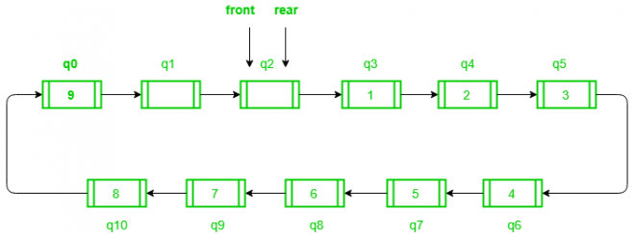
ISRO | ISRO CS 2014 | Question 36
Consider a standard Circular Queue ‘q’ implementation whose size is 11 and the elements of the queue are q[0], q[1], q[2]…..,q[10]. The front and rear pointers are initialized to point at q[2] .
In which position will the ninth element be added? (A) q[0] (B) q[1] (C) q[9] (D) q[10]
Answer: (A) Explanation: Circular queue whose total size is 11, front and rear pointers are initialized to point at q[2]:
Therefore, 9th element will be added at pointer q[0].
So, option (A) is correct.

Slide 14
GATE | Gate IT 2007 | Question 30
Suppose you are given an implementation of a queue of integers. The operations that can be performed on the queue are:
i. isEmpty (Q) — returns true if the queue is empty, false otherwise.
ii. delete (Q) — deletes the element at the front of the queue and returns its value.
iii. insert (Q, i) — inserts the integer i at the rear of the queue.
Consider the following function:
void f (queue Q) {
int i ;
if (!isEmpty(Q)) {
i = delete(Q);
f(Q);
insert(Q, i);
}
}
What operation is performed by the above function f ?
(A) Leaves the queue Q unchanged
(B) Reverses the order of the elements in the queue Q
(C) Deletes the element at the front of the queue Q and inserts it at the rear keeping the other elements in the same order
(D) Empties the queue Q

Slide 15
GATE | Gate IT 2007 | Question 30
Suppose you are given an implementation of a queue of integers. The operations that can be performed on the queue are:
i. isEmpty (Q) — returns true if the queue is empty, false otherwise.
ii. delete (Q) — deletes the element at the front of the queue and returns its value.
iii. insert (Q, i) — inserts the integer i at the rear of the queue.
Consider the following function:
void f (queue Q) {
int i ;
if (!isEmpty(Q)) {
i = delete(Q);
f(Q);
insert(Q, i);
}
}
What operation is performed by the above function f ?
(A) Leaves the queue Q unchanged
(B) Reverses the order of the elements in the queue Q
(C) Deletes the element at the front of the queue Q and inserts it at the rear keeping the other elements in the same order
(D) Empties the queue Q
Answer: (B) Explanation: As it is recursive call, and removing from front while inserting from end,
That means last element will be deleted at last and will be inserted 1st in the new queue.
And like that it will continue till first call executes insert(Q,i) function. So, the queue will be in reverse.

Slide 16
0 | 1 | 2
99 | 88 | 77
GATE | Gate IT 2007 | Question 30
Consider the following function:
void f (queue Q) {
int i ;
if (!isEmpty(Q)) {
i = delete(Q);
f(Q);
insert(Q, i);
}
}
f(Q)
If (!isEmpty(Q))= if (!FALSE)=if(TRUE)
i=99 Delete operation
f(Q with front pointing at 88)
if(!isEmpty(Q))=if(TRUE)
i=88 Delete Operation
f(Q with front pointing 77)
if(TRUE)
F
R
0 | 1 | 2
 | 88 | 77
F
R
0 | 1 | 2
 |  | 77
F
R

Slide 17
0 | 1 | 2
 |  | 77
GATE | Gate IT 2007 | Question 30
Consider the following function:
void f (queue Q) {
int i ;
if (!isEmpty(Q)) {
i = delete(Q);
f(Q);
insert(Q, i);
}
}
f(Q with front pointing 77)
if(TRUE)
i=77 Delete Operation
f(Q with F,R =-1)
if(FALSE)
Come Out of F(Q)
insert(Q,i=77)
Return to Parent IF Block
Insert 88
F
R
0 | 1 | 2
F,R=-1
0 | 1 | 2
77
F
R

Slide 18
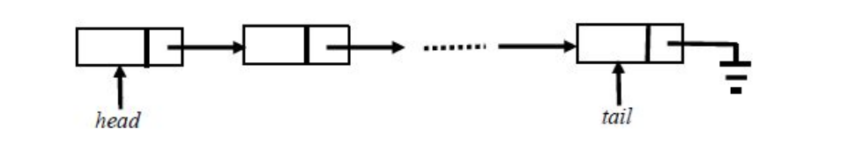
GATE | GATE CS 2018 | Question 11
A queue is implemented using a non-circular singly linked list. The queue has a head pointer and a tail pointer, as shown in the figure. Let n denote the number of nodes in the queue. Let ‘enqueue’ be implemented by inserting a new node at the head, and ‘dequeue’ be implemented by deletion of a node from the tail.
Which one of the following is the time complexity of the most time-efficient implementation of ‘enqueue’ and ‘dequeue, respectively, for this data structure? (A) Θ(1), Θ(1) (B) Θ(1), Θ(n) (C) Θ(n), Θ(1) (D) Θ(n), Θ(n)

Slide 19
GATE | GATE CS 2018 | Question 11
A queue is implemented using a non-circular singly linked list. The queue has a head pointer and a tail pointer, as shown in the figure. Let n denote the number of nodes in the queue. Let ‘enqueue’ be implemented by inserting a new node at the head, and ‘dequeue’ be implemented by deletion of a node from the tail.
Which one of the following is the time complexity of the most time-efficient implementation of ‘enqueue’ and ‘dequeue, respectively, for this data structure? (A) Θ(1), Θ(1) (B) Θ(1), Θ(n) (C) Θ(n), Θ(1) (D) Θ(n), Θ(n)
Answer: (B)
Explanation: For Enqueue operation, performs in constant amount of time (i.e., Θ(1)), because it modifies only two pointers, i.e.,
Create a Node P.
P-->Data = Data
P-->Next = Head
Head = P
For Dequeue operation, we need address of second last node of single linked list to make NULL of its next pointer. Since we can not access its previous node in singly linked list, so need to traverse entire linked list to get second last node of linked list, i.e.,
temp = head;
While( temp-Next-->Next != NULL){
temp = temp-Next;
}
temp-->next = NULL;
Tail = temp;
Since, we are traversing entire linked for each Dequeue, so time complexity will be Θ(n).

Slide 20
Data Structures | Queue | Question 11
Suppose a circular queue of capacity (n – 1) elements is implemented with an array of n elements. Assume that the insertion and deletion operation are carried out using REAR and FRONT as array index variables, respectively. Initially, REAR = FRONT = 0. The conditions to detect queue full and queue empty are
(A) Full: (REAR+1) mod n == FRONT, empty: REAR == FRONT
(B) Full: (REAR+1) mod n == FRONT, empty: (FRONT+1) mod n == REAR
(C) Full: REAR == FRONT, empty: (REAR+1) mod n == FRONT
(D) Full: (FRONT+1) mod n == REAR, empty: REAR == FRONT

Slide 21
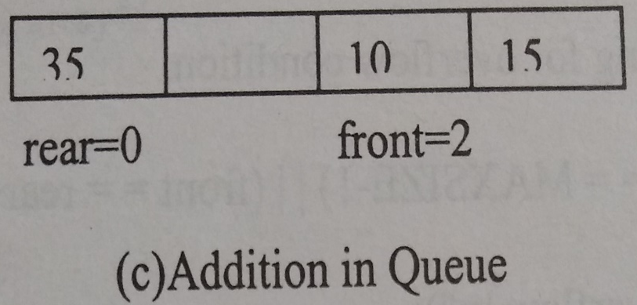
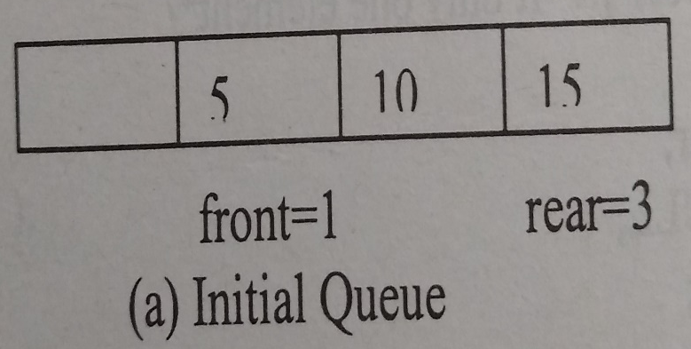
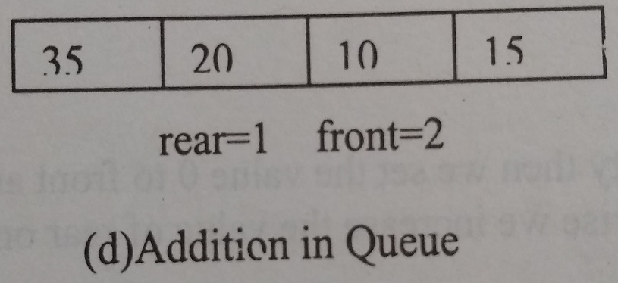

Working of Circular Queue

Slide 22
Data Structures | Queue | Question 11
Suppose a circular queue of capacity (n – 1) elements is implemented with an array of n elements. Assume that the insertion and deletion operation are carried out using REAR and FRONT as array index variables, respectively. Initially, REAR = FRONT = 0. The conditions to detect queue full and queue empty are
(A) Full: (REAR+1) mod n == FRONT, empty: REAR == FRONT
(B) Full: (REAR+1) mod n == FRONT, empty: (FRONT+1) mod n == REAR
(C) Full: REAR == FRONT, empty: (REAR+1) mod n == FRONT
(D) Full: (FRONT+1) mod n == REAR, empty: REAR == FRONT
Answer: (A)
Explanation:
In the beginning when the queue is empty, FRONT and REAR point to 0 index in the array.
REAR represents insertion at the REAR index.
FRONT represents deletion from the FRONT index.
When Queue Empty :
REAR was equal to FRONT when empty ( because in the starting before filling the queue FRONT = REAR = 0 )

Slide 23
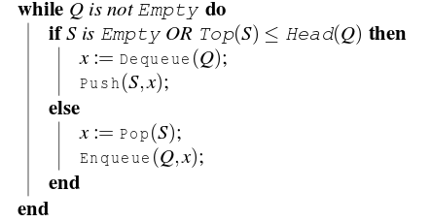
GATE | GATE-CS-2016 (Set 1) | Question 51
Let Q denote a queue containing sixteen numbers and S be an empty stack. Head(Q) returns the element at the head of the queue Q without removing it from Q. Similarly Top(S) returns the element at the top of S without removing it from S. Consider the algorithm given below.
The maximum possible number of iterations of the while loop in the algorithm is______ [This Question was originally a Fill-in-the-Blanks question]
(A) 16 (B) 32 (C) 256 (D) 64

Slide 24
If Stack is Empty or Top of Stack is less than Front Element of Queue then
Delete the Front Element from Queue & Push in Stack
Else
Pop Element from Stack & Insert in Queue

Slide 25
Answer: (C)
Explanation: The worst case happens when the queue is sorted in decreasing order. In worst case, loop runs n*n times.
Queue: 4 3 2 1
Stack: Empty
Q=3 2 1
S=4
Q=3 2 1 4
S=Empty
Q=2 1 4
S=3
Q=2 1 4 3
S=Empty
Q=1 4 3
S=2
Q=1 4 3 2
S=Empty
Q=4 3 2
S=1
If Stack is Empty or Top of Stack is less than Front Element of Queue then
Delete the Front Element from Queue & Push in Stack
Else
Pop Element from Stack & Insert in Queue

Slide 26
Q=3 2
S=1 4
Q=3 2 4
S=1
Q=2 4
S=1 3
Q=2 4 3
S=1
Q=4 3
S=1 2
Q=3
S=1 2 4
Q=3 4
S=1 2
Q=4
S=1 2 3
Q=Empty
S=1 2 3 4

Slide 27
The end

